Slide 1
Teaching Syntax Online
Teaching Hybrid and Fully Online: Best Practices in Course Development and Delivery
Lynn Santelmann
Portland State University
January 7, 2021

Slide 2
Preface
Two books that I’ve found very useful:
Brown, P. C., Roediger III, H. L., & McDaniel, M. A. (2014). Make it stick: The science of successful learning. Bellknap Press of Harvard University Press.
Nilson, L. B., & Goodson, L. A. (2018). Online teaching at its best: Merging instructional design with teaching and learning research. Jossey-Bass.

Slide 3
Teaching syntax
Take 2 minutes think about:
What do/would you do when you teach syntax face-to-face (either in an Intro to Linguistics course or a Syntax course)?
Where do students struggle when learning syntax?
What aspects of syntax present an additional challenge for online teaching and learning?
Be ready to share your answers either in large group or via chat

Slide 4
What do students need to learn syntax? Practice, practice, practice, practice
Research in cognitive science has demonstrated that students learn best when they get
Practice with targeted feedback
Practice where they interact with others to construct knowledge
Spaced, interleaved practice
Multiple ways of receiving and practicing information

Slide 5
Other findings from cognitive science that can lead to greater learning (online or face-to-face)
Desirable difficulties – something that makes us work harder to learn (but not too hard)
Self-testing or some other way to retrieve (not just recognize) new information (requires more cognitive effort)
An opportunity to correct and learn from errors
Immediate feedback is great
Frequent opportunities for recall, generation of answers, and application
Elaborative rehearsal – thinking about new material and connecting it to prior knowledge

Slide 6
How to achieve in synchronous or hybrid online courses?
Synchronous online instruction:
Build in small group work for every class
Use formative feedback and spend class time discussing
Consider a flipped or partially flipped classroom
Technology suggestion for online trees for group work: Google Jamboard: https://jamboard.google.com/
Example: https://jamboard.google.com/d/17wXjIwvF0S4okbenFqB3HhMLENcXjasHTG4pC_l9-tc/viewer?f=0

Slide 7
Try it out
Jamboard activity – follow link (in chat) and complete the activity
https://jamboard.google.com/d/1uy9P3jq-t6MsAZ1sdGVjPOhePFNBHjJx_o04o9FXbko/edit?usp=sharing

Slide 8
How to move syntax to an asynchronous course?
First: “For several decades, we have known the value of student interactions with the instructor, the course content, classmates, and technology in online courses … When these interactions develop instructor, cognitive, and social presence, they help students feel part of a community, which sustains their persistence in online courses …well-designed interactions keep students from feeling the sense of isolation that often leads them to withdraw.” (Nilson & Goodson, 2018, pp. 131-132)

Slide 9
Repeated interleaved practice with self-correct homework (a shameless plug)
Self-correct homework for syntax tree drawing: https://lingscholarlyteaching.wordpress.com/2021/01/02/poster-c6/
Self-correct homework online:
Students complete homework on their own & submit uncorrected homework to assignment folder
Access answers, correct homework, describe errors, resubmit
Students discuss questions in the discussion forums

Slide 10
Teaching tips for asynchronous
Create short videos that demonstrate process – students benefit from seeing you do the steps multiple times
Encourage discussion – pose questions that have multiple possible answers
Have students collaborate on building arguments
Create opportunities for students to get appropriate, repeated, interleaved practice

Slide 11
Benefits of self-correct homework
Students test themselves, get spaced and interleaved practice, generate answers, reflect on errors
The formative nature with student corrections promotes learning and normalizes mistakes.
Students are involved in providing the feedback
They get both immediate feedback and delayed

Slide 12
Possible other ideas for asynchronous teaching
Pair students up – have each do ½ of a set of problems, then have their partners look at the answers, ask questions/suggest corrections, and have students submit jointly
Spot the difference activities – one right, one wrong tree, and have students (a) spot the difference and (b) determine what the difference
Have students record themselves “solving” complex tree and submit video.
Depends on class size (3 minute video x 30 = 90 min grading time; 3 min. x 75 = 3 ½ hours!)

Slide 13
What do you think would work for asychronous syntax?
Reflect for a few minutes on other ways you could approach teaching syntax which is very procedural and very visual online
How can we make sure online syntax is accessible to all students

Slide 14
Appendix Tools for Drawing Trees

Slide 15
Ways for instructors to draw trees
Google jamboard: jamboard.google.com
Zoom whiteboard or other whiteboard website
Tablets with stylus connected to Zoom/Google Meets

Slide 16
Hand-drawing trees
Student do not need to use technology to draw trees. I encourage my students to use pencil and paper.
Students can draw on paper, take a picture with their phone, and then convert the pictures to a pdf using an app.
Some students used draw/paint programs and submit pictures
Some students used other diagrams (organization chart?)

Slide 17
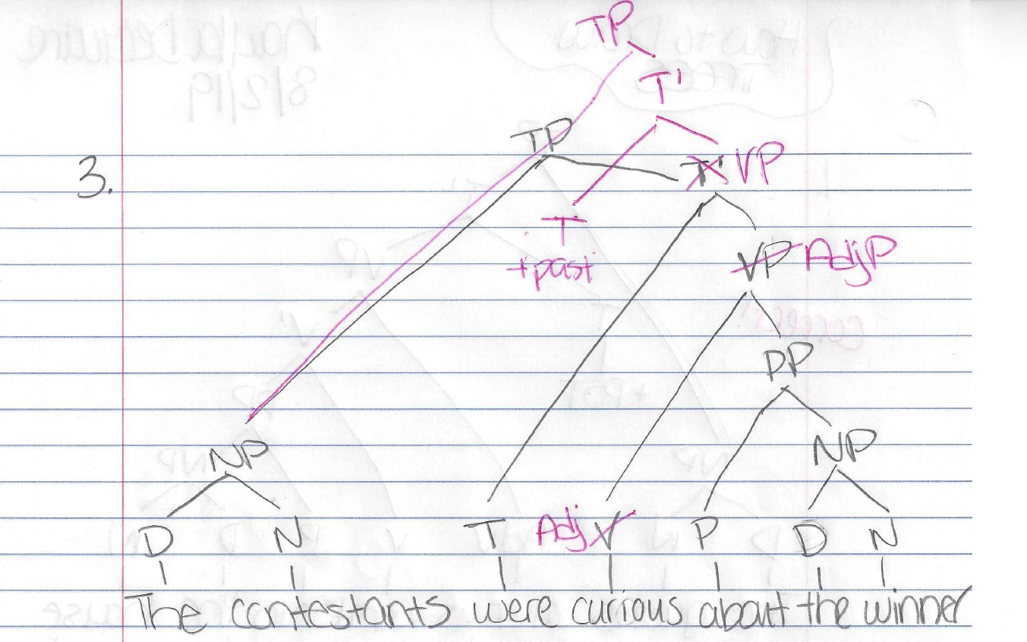
Example of student work uploaded

