Slide 1
Online Courses and ADA Compliance
Gaillynn Clements
LiHEC, Linguistic Society of America
Jan 7, 2021 Virtual Conference
Notes:
First let me say creating course content that transitions well online is time consuming. Adding ADA compliance to building that course content takes even longer to create.

Slide 2
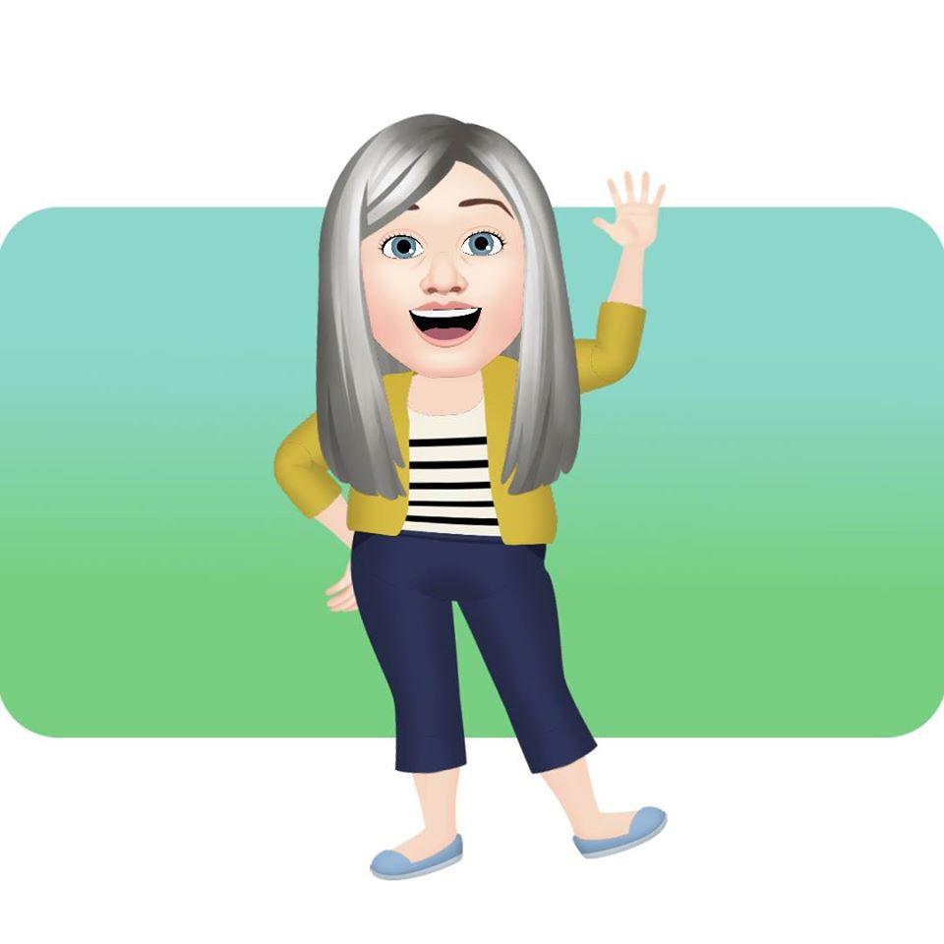
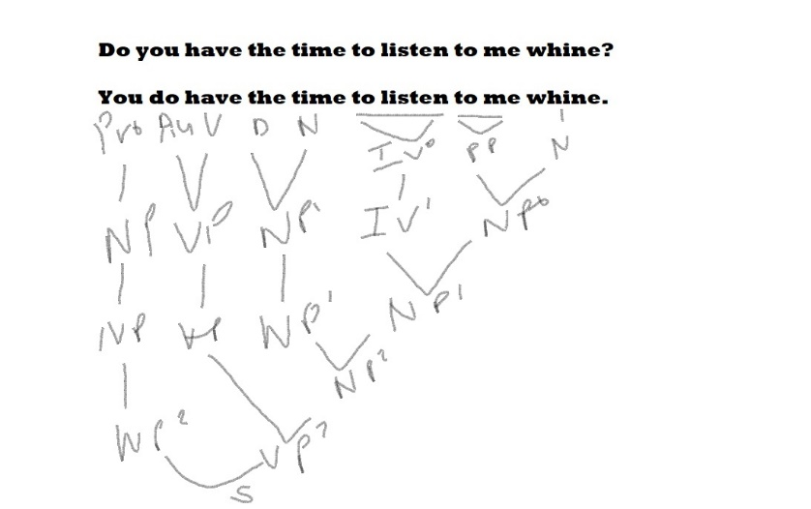
Presentation Focus
This presentation focuses on Cognitive and Physical/Motor Disabilities.
Visual and Auditory/Oral disabilities are covered in a video discussion created by Dr. Michael Rushforth. It is included on the last slide of this presentation.
Hard to maintain focus here.

Slide 3
Practical Items
Students with visual difficulties may:
Need a screen reader and the keyboard to access what's on the computer,
Not be able to use a mouse,
Not be able to tell one color from another., and/or
Need to enlarge text and illustrations in order to see them (This slide is a perfect example of too much on one slide, split it up into 4 slides).
Students with hearing difficulties can have problems hearing the audio in podcasts, voice-over PowerPoints, videos, and other online media.
Students with cognitive disabilities may:
Have trouble reading text or interpreting illustrations,
Use a screen reader to help them understand text,
Be confused by complex layouts or navigation schemes, and/or
Have trouble focusing on or comprehending lengthy sections of text, audio, or video.
Students with paralysis and/or fine and gross motor control disabilities may:
Not be able to access content that requires a mouse,
Need to use assistive technologies like head wands and voice-recognition software to access a course,
Have slow response time, and/or
Become easily fatigued by movements that wouldn’t be tiring for most people.

Slide 4
Practical Items
Re-imagined on the next 5 slides

Slide 5
Practical Items: Visual Difficulties
Students with visual difficulties may:
Need a screen reader and the keyboard to access what's on the computer,
Not be able to use a mouse,
Not be able to tell one color from another, and/or
Need to enlarge text and illustrations in order to see them. The first Practical Items slide is a perfect example of too much on one slide, so I split it up into 4 slides.

Slide 6
Practical Items: Hearing Difficulties
Students with hearing difficulties can have problems hearing the audio in podcasts, voice-over PowerPoints, videos, and other online media.

Slide 7
Practical Items: Cognitive Disabilities
Students with cognitive disabilities may:
Have trouble reading text or interpreting illustrations,
Use a screen reader to help them understand text more easily (NVDA has a free/donation download; you can check your pages.),
Be confused by complex layouts or navigation schemes, and/or
Have trouble focusing on or comprehending lengthy sections of text, audio, or video.
Not all animations are the same… (endangered animals examples)… https://24slides.com/presentbetter/bad-powerpoint-examples-you-should-avoid/

Slide 8
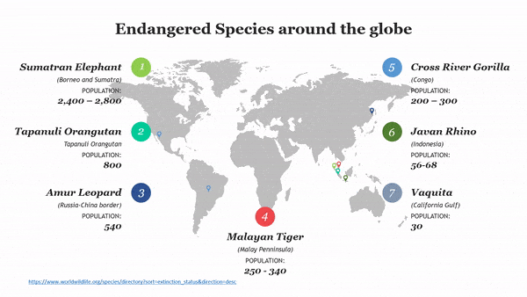

Slide 9
Practical Items: Motor Disabilities
Students with paralysis and/or fine and gross motor control disabilities may:
Not be able to access content that requires a mouse,
Need to use assistive technologies like head wands and voice-recognition software to access a course,
Have slow response time, and/or
Become easily fatigued by movements that wouldn’t be tiring for most people.

Slide 10
What is your motivation?
Do you need to accommodate one individual with a specific disability?
For example, I had a student this past Fall with hearing difficulties. She recorded¹ lectures, and I sent all videos and clips to Duke’s Student Disability Access Office. The office made sure each was closed captioned properly and sent it back to me within a couple of days (YouTube’s CC is far from perfect, especially with certain dialectal and accent speakers).
This retrofit approach, if you have a similar individual student with one, specific disability, is usually a straightforward and technologically simple way to accommodate a student.
1. Students at Duke University are required to sign a statement that they will not publicly post recorded lectures since other students in the course did not give permission to be recorded.

Slide 11
What is your motivation continued?
Do you want to create an online course that takes current or future students’ needs into consideration?
Instead of retrofitting, consider course accessibility as you build your online course from the ground up. Integral accessibility is paramount to creating an online course that provides multiple ways for students to gain knowledge, demonstrate knowledge, and interact. It also goes a long way toward making a course accessible to all students, including those with disabilities.

Slide 12
Cognitive: Consistency
Ensure that navigation is consistent throughout a site
Navigation placement, display, and functionality should not change from page to page
Similar interface elements and similar interactions should produce predictably similar results

Slide 13
Cognitive: Transformability
Page should support increased text sizes The page should remain readable and functional when text is increased 200-300%.
Should ensure images are readable and comprehensible when enlarged (DO NOT DELETE THEM) Content within images, particularly text, should be understandable when the image is scaled 200-300%. Use true text instead of text within images when feasible.
Ensure color alone is not used to convey content If page colors are removed or changed, content should not be lost.
Hearing: Availability of ppts and videos/images ahead of time for the student and interpreter
Hearing: ASL signs for terminology ahead of time to
?Support the disabling of images and/or styles? Some believe text-only versions make pages or platforms more accessible. Many, esp. with dyslexia or other cognitive disabilities) would benefit greatly from more graphics, more multimedia, and visual styling. In these cases, the text-only version may actually be less accessible than the original version. This often holds true for sighted users across wide spectrum of disabilities. This supports the multi-modal learning on the next slide (using differing senses reduces boredom, differing skills, heightens synthesis of materials, and different learning styles access more students’ needs).

Slide 14
Cognitive: Multi-Modality
Provide content in multiple mediums Video or audio alternatives provide an additional method of perceiving content. A text alternative (captions and/or a transcript) should be provided for video and audio content. Closed captioning, which gives users the option to turn off the captions, is optimal.
Use images to enhance content Images can be used to convey or enhance content. Illustration, diagrams, icons, and animations can convey complex information.
Pair icons or graphics with text to provide contextual cues and help with content comprehension

Slide 15
Cognitive: Focus and Structure
Avoid distractions Animation, varying or unusual font faces, contrasting color or images, or other distracters that pull attention away from content should be avoided. Complex or "busy" background images can draw attention away from the content. Some animation, visuals, or videos can enhance the content. Avoid pop-up windows and blinking or moving elements.
Use stylistic differences to highlight important content, but do so conservatively Use various stylistic elements (italics, bold, color, brief animation, or differently-styled content) to highlight important content. Overuse can result in the loss of differentiation. Do not use italics or bold on long sections of text. Avoid ALL CAPS.
Organize content into well-defined groups or chunks, using headings, lists, and other visual mechanisms Break long pages into shorter sections with appropriate headings (use true and visually significant headings rather than simply big bold text). Very long pages may be divided into multiple, sequenced pages. Unordered, ordered, and definition lists provide a visual structuring and convey semantic meaning (e.g., an unordered list conveys a group of parallel items). Use shorter, multi-step forms for complex interactions, rather than lengthy, all-in-one forms.
Use white space for separation White space is a design term that refers to empty space between elements in a page. It is not necessarily the color white. White space should be used to separate navigation from main body, body text from side elements and footer, main content from supplementary items (floating boxes, for example) and to separate headings, paragraphs, and other body text.
Avoid background sounds Give the user control over playing audio content within the page, or at a minimum, give the user control to stop the background sounds.

Slide 16
Cognitive: Focus and Structure Re-imagined
Organize Content: Well-defined chunks, with headings, lists, organize content. Break long pages into shorter sections with appropriate headings. Divide long pages into multiple, sequenced pages.
Avoid Distractions: Use animation to enhance content, so not much many, no "busy" background images, blinking or moving images.
Use White Space: The design of a page (white space, color, images, etc.) should focus the user on what is most important (typically the body content of that page).
Stylistic Differences: Use to highlight important content, but do so conservatively: Use various stylistic elements (italics, bold, color, brief animation, or differently-styled content) to highlight important content.
Avoid Background Sounds: Give users control over playing audio content, or at a minimum, give users control to stop background sounds.

Slide 17
Cognitive: Focus and Structure Re-imagined Again
https://ezgif.com/maker

Slide 18
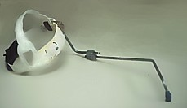
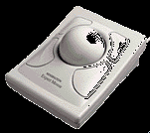
Physical
First, most assistive technologies for people with motor disabilities either work through the keyboard or emulate the functionality of the keyboard. Knowing this ahead of time allows for modules, assignments, and other course work to be set up with as few keystrokes as possible before getting to key course content.
Secondly, some assistive technologies can cause fatigue, such as the head wand or trackball mouse (especially for those with hand tremors). Again, creating assess to content with the fewest strokes or necessary clicks is preferable.
Adaptive keyboards, voice recognition, and eye tracking software are other assistive technologies for those with physical disabilities.

Slide 19
Physical Example
A student in my Introduction to Linguistics class had a physical disability which limited the use of his hands and upper body. I was not given ample time to overhaul the course. After online conversations with an extremely helpful Accommodations Officer and getting to know the student and his physical needs and adaptations, I was able to restructure the second half of course, creating modules with fewer clicks needed to access videos, assignments, and other course content on Sakai.
He already used a keyboard overlay. An overlay (literally overlaid on a regular keyboard) is similar to an adaptive keyboard. His had raised areas between the keys. This allowed him to slide his fingers to the correct keys without pressure on every key his fingers slid over.

Slide 20
Physical Example Continued
The keyboard overlay and my restructuring of the course’s online content helped with accessibility for tests and homework assignments except when it came to drawing morphological and phrase structure trees. He ended up using a sip-and-puff system (his was a Jouse) that allowed control of a device using any part of the mouth, cheek, chin or tongue. It worked with Adobe Photoshop, and he also tried it in Paint with success. Due to its accuracy and quick response, he was able to use it to draw complex phrase structure trees (and he also emailed that its fast response and detailed movements made it possible for him to play computer video games).
Jouse sample video: https://www.youtube.com/watch?v=4_e_0fI7i3A (Turn on CC and see the YouTube CC software substitute “cows” and “jobs” for Jouse. Also, the video is not of the best quality for students with visual difficulties as it zooms quickly, shakes a bit, and as the camera moves the lighting changes.)

Slide 21
Online Module Example
Without a universal design standard, every university or online program uses its own learning management system.
Once the student logs on to Sakai, it takes a click on our class, a click on the Resources tab, a click on the specific module (Syntax: Phrase Structure Trees), and then a final click on the specific file the student needs. Picture on the next slide.

Slide 23
Some Further Sources
Sources: Educause Review, Inside HigherEd, but by far the most comprehensive online source I have found is Utah State University’s Web Accessibility in Mind at WebAIM.org. It is searchable and has even more considerations for accessibility than can be discussed in the time today. Make sure to consult your university’s Disability and Accommodation office and talk to the students to see what has helped them in the past and where they have had difficulties.
Dr. Michael Rushforth’s Video (mentioned previously): https://www.youtube.com/watch?v=Lm_zWsyYhes&feature=youtu.be

