Slide 1
Preparing Linguistics Graduate Students to Teach
LSA Linguistics in Higher Education Committee
Ann Bunger, Indiana University
Gaillynn Clements, Duke University and University of North Carolina School of the Arts
Miranda McCarvel, University of Utah
Evan Bradley, Penn State Brandywine
Jon Bakos, Indiana State University
David Bowie, University of Alaska Anchorage
Lynn Burley, University of Central Arkansas
Anne Charity Hudley, University of California, Santa Barbara
Sonja Launspach, Idaho State University
Alex Motut, University of Toronto
LSA Annual Meeting
1/4/2017
Salt Lake City

Slide 2
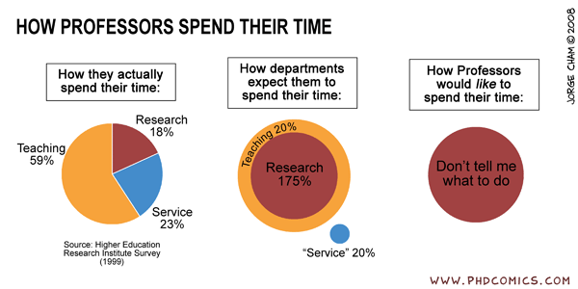

Slide 3
The Challenge
“The tendency to devalue teacher preparation in parts of doctoral education is at odds with the ever-growing national pursuit of effective teaching.”
– MLA Task Force on Doctoral Study in Modern Language and Literature, 2014

Slide 4
Our Goal
To start a conversation about how we are training linguistics graduate students to teach.
What kind of skills do teachers of linguistics need?
What kind of training programs are being implemented?
What are their strengths and weaknesses?
How can the effectiveness of a training program be evaluated?
What first steps might a unit take to develop a training program?
What’s on the horizon?

Slide 5
Panelists
Moderator:
Raichle Farrelly, St. Michael’s College
Presenters:
Anne Curzan, University of Michigan
Julia Moore & Matt Goldrick, Northwestern University
Alexandra Motut, University of Toronto
Mary Niepokuj, Purdue University

Slide 6
Panel Format
Introduction
Panelist presentations
Series of questions
Additional discussion

Slide 7
First Steps for Developing a Training Program
Keep an eye out for recommendations after the conference. When the document is complete, it will be available here:
bit.ly/2kLbMic
Or contact Ann Bunger for more information:
acbunger@indiana.edu

